Slide 1
Advanced Systems Analysis and Design Source Control Systems SOFT 30121 L15

Slide 2


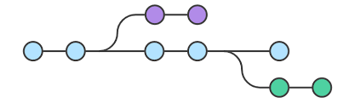
Source Control Systems

Slide 3
Source Control Systems
Objectives of Lecture 8
Understand the purpose of git as a source control system
Learn the meaning of git terminology such as branch and merge
Understand how you can use git and GitHub as part of your software development workflow
SOURCE: RecoSystems Analysis and Design
Alan Dennis; Barbara Haley Wixom; Roberta M. Roth
2019
Chapter 5

Slide 4
Those of you who haven’t used git before…
Where are you storing your software development projects? Google Drive? Just on your laptop? USB sticks?!
How do you make sure everyone is working on the most up to date version of the project?
What do you do when you want to integrate features developed by the members of the team?

Slide 5

Git vs GitHub
Git is open source version control software. It is normally used to track changes in source code during software development, but could be used with any set of files
GitHub is a website that provides hosting for git repositories. As well as supporting git, it also offers it’s own features.

Slide 6
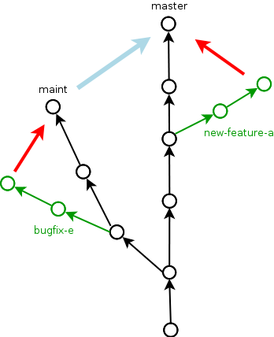
How does git work?
Git takes “snapshots” of your files, and tracks them. It stores these snapshots in a tree like structure
It is possible to form “branches” which are often used when developers are working on different features. These branches can later be merged.
Some terminology…
Repository (repo): the place where your code is stored. The “local” repo refers to the repo stored on your computer, the “remote” repo is stored on your hosting provider e.g. GitHub
Commit: A point in history in the repository.
Stage: the place where files are before being committed

Slide 7
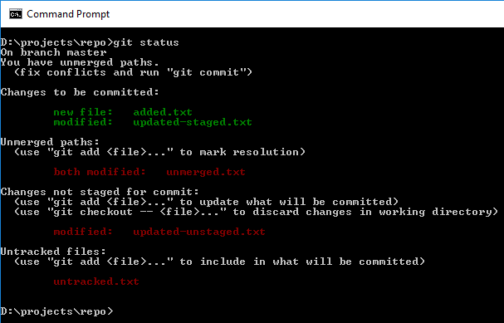
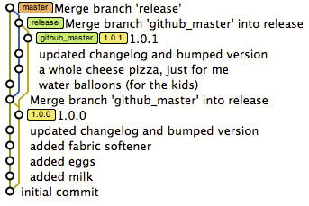
How best to use git?
The git command line tool lets you use all of git’s features through the command line (either through BASH or windows CMD)
Git GUIs provide a graphical user interface that those who don’t like using the command line can use.
Some of these make it easier to visualise your projects history. These include:
SourceTree
gitKraken
Tortoisegit
GitHub desktop is available on software hub on campus

Slide 8

Git workflow (At it’s simplest)
Clone/initialise a repository (git clone/git init)
Edit/add files to the project
Add the changed files to the staging area (git add)
Commit the changes to the repository (git commit)
Go back to step 2 and repeat.

Slide 9
Branching to work on new features
It’s common practice to create a new branch whenever you start work on a new feature (or user story), then merge back into the main/master branch when you’re finished
The GitHub Branched Based workflow looks like this:
Create a new branch so any new ideas don’t affect the main/master branch. (If it isn’t deployable, it shouldn’t be in main!)
Make some commits to this new branch as this featured is worked on
Make a pull request to the main branch when the feature is finished. This initiates discussion with the rest of your team about your commits.
Discuss and review your code Is your change missing unit tests? Coding style? Does it match project guidelines?
Merge into main! Once your pull request has been reviewed and the branch passes your tests, you can deploy your changes to verify them in production. Often teams have a specially provisioned test environment that is deployed to first.
*the default branch in git used to be called the master branch, but to remove unnecessary references to slavery, the default branch on repos created using GitHub is main. The term “main” will be used from here

Slide 10
Merging
To merge back into main:
Switch back to the main branch using:
git checkout main
(it’s important to be on the branch you’re merging into, which in this case is main.)
Merge the new feature into main:
git merge new-feature-branch
Git will then merge the changes automatically (most of the time)
Sometimes a merge conflict occurs (e.g. when two developers have changed the same file.)

Slide 11
.gitignore
Compilation output and your IDE user settings do not belong in source control! Luckily you can get git to ignore these:
A .gitignore specifies files that git should ignore
These should include files you don’t need/want in your repo. Including:
Dependency caches (node_modules is a notorious example)
Compiled code
Files generated at runtime
Personal IDE config files (like .idea/workspace.xml)
gitignore.io can be used to generate gitignore files for you

Slide 12
Tips on good source control management
If it’s not in source control, it doesn’t exist
The only measure of progress is working code in source control
Commit early, commit often
Each committed revision gives you a rollback position
It reduces the number of merge conflicts that need to be fixed at once
Always inspect your changes before committing
Stops you uploading files to the repo that don’t need to be there
A well maintained gitignore makes this easier
Consider your teammates when writing commit messages
Commit messages should explain why you committed the code
These can be useful when you want to see the entire history of a file
Source: https://www.troyhunt.com/10-commandments-of-good-source-control/

Slide 13
Other resources:
There’s more information/examples on this weeks learning room page
These explain git’s internal structure in more detail

Slide 14
Next Lecture
Moving into implementation

